Slide 1
Mobile Musical Moments
Project Manager: Scott Thompson
Development Team: Joshua Brungar, Quentin Griffiths, Stephen Nancekivell, Simon Wadsworth

Slide 2


Slide 3
The Vision
To provide a software package that will allow a customer to record a currently playing song, and have it return the name and artist of the song.

Slide 4
Licensing
Our software package uses some closed source code – Entropy Fingerprinting Algortihm

Slide 5
Audio Recording
No premade features in the .NET Compact Framework for dealing with WAV files
To overcome this our own classes needed to be written
[How the recording works]

Slide 6
Interface
Buttons and Controls
Splash Screen
Outflow Layout

Slide 7
Interface

Slide 8
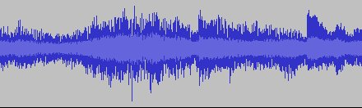
How we fingerprint audio.
More more less more less

Slide 9
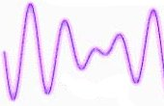


Fingerprint Robustness.

Slide 10
The Backend
The backend essentially consists of a server that accepts simple queries from the device and returns an answer
It’s written as a threaded C# TCP Network application
It’s all string based

Slide 11
The Backend Server
CLIENT
SERVER
Challenge

Slide 12
The Backend Server – Concurrency Problem
INCOMING CONNECTION
INCOMING CONNECTION
INCOMING CONNECTION
SERVER
Notes:
Server will only allow one connection at a time

Slide 13
The Backend Server – Concurrency Problem
INCOMING CONNECTION
INCOMING CONNECTION
INCOMING CONNECTION
SERVER
Connection Thread #1
Connection Thread #3
Connection Thread #2
Notes:
Solution: Put each connection into a thread. Each incoming connection will go into its own thread.

Slide 14
The Backend Server
CLIENT
SERVER
Fingerprint
Returned Data
In XML format
Comparison
Song List

